Slide 1
FDA – Food Recall
Andy O’Bryan
Jake Rose
Stacey Smoot

Slide 2

Data Used
FDA API
Food enforcement json file
Data year: 2016
Records number: xxx
Zippopotam API
Zip code information
Languages
JavaScript
HTML
CSS
Notes:
Data year used is the date the recall was initiated

Slide 3
US Map

Slide 4
Classification Table
First bullet point here
Second bullet point here
Third bullet point here
Status | Terminated | Ongoing
Voluntary | 82 | 95
Mandated | 76 | 88

Slide 5
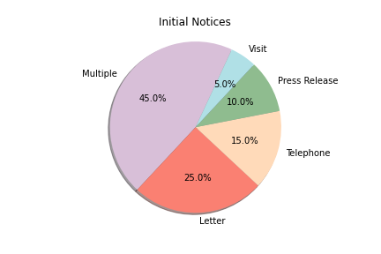
FDA Notices
Notes:
There are many ways to notice others of a recall. This is a pie chart of how the initial notice selection was given.

Slide 6
Add a Slide Title - 1

Slide 7
Add a Slide Title - 2

Slide 8
Add a Slide Title - 3

Slide 10
Add a Slide Title - 4

Slide 11
Add a Slide Title - 5

